Slide 1
NCR Manager
Crossfire NCR Overhaul
Powered by Adestria Solutions
Notes:
Steve

Slide 2
Data Model
Pain Points
Q & A
Notes:
Steve

Slide 3
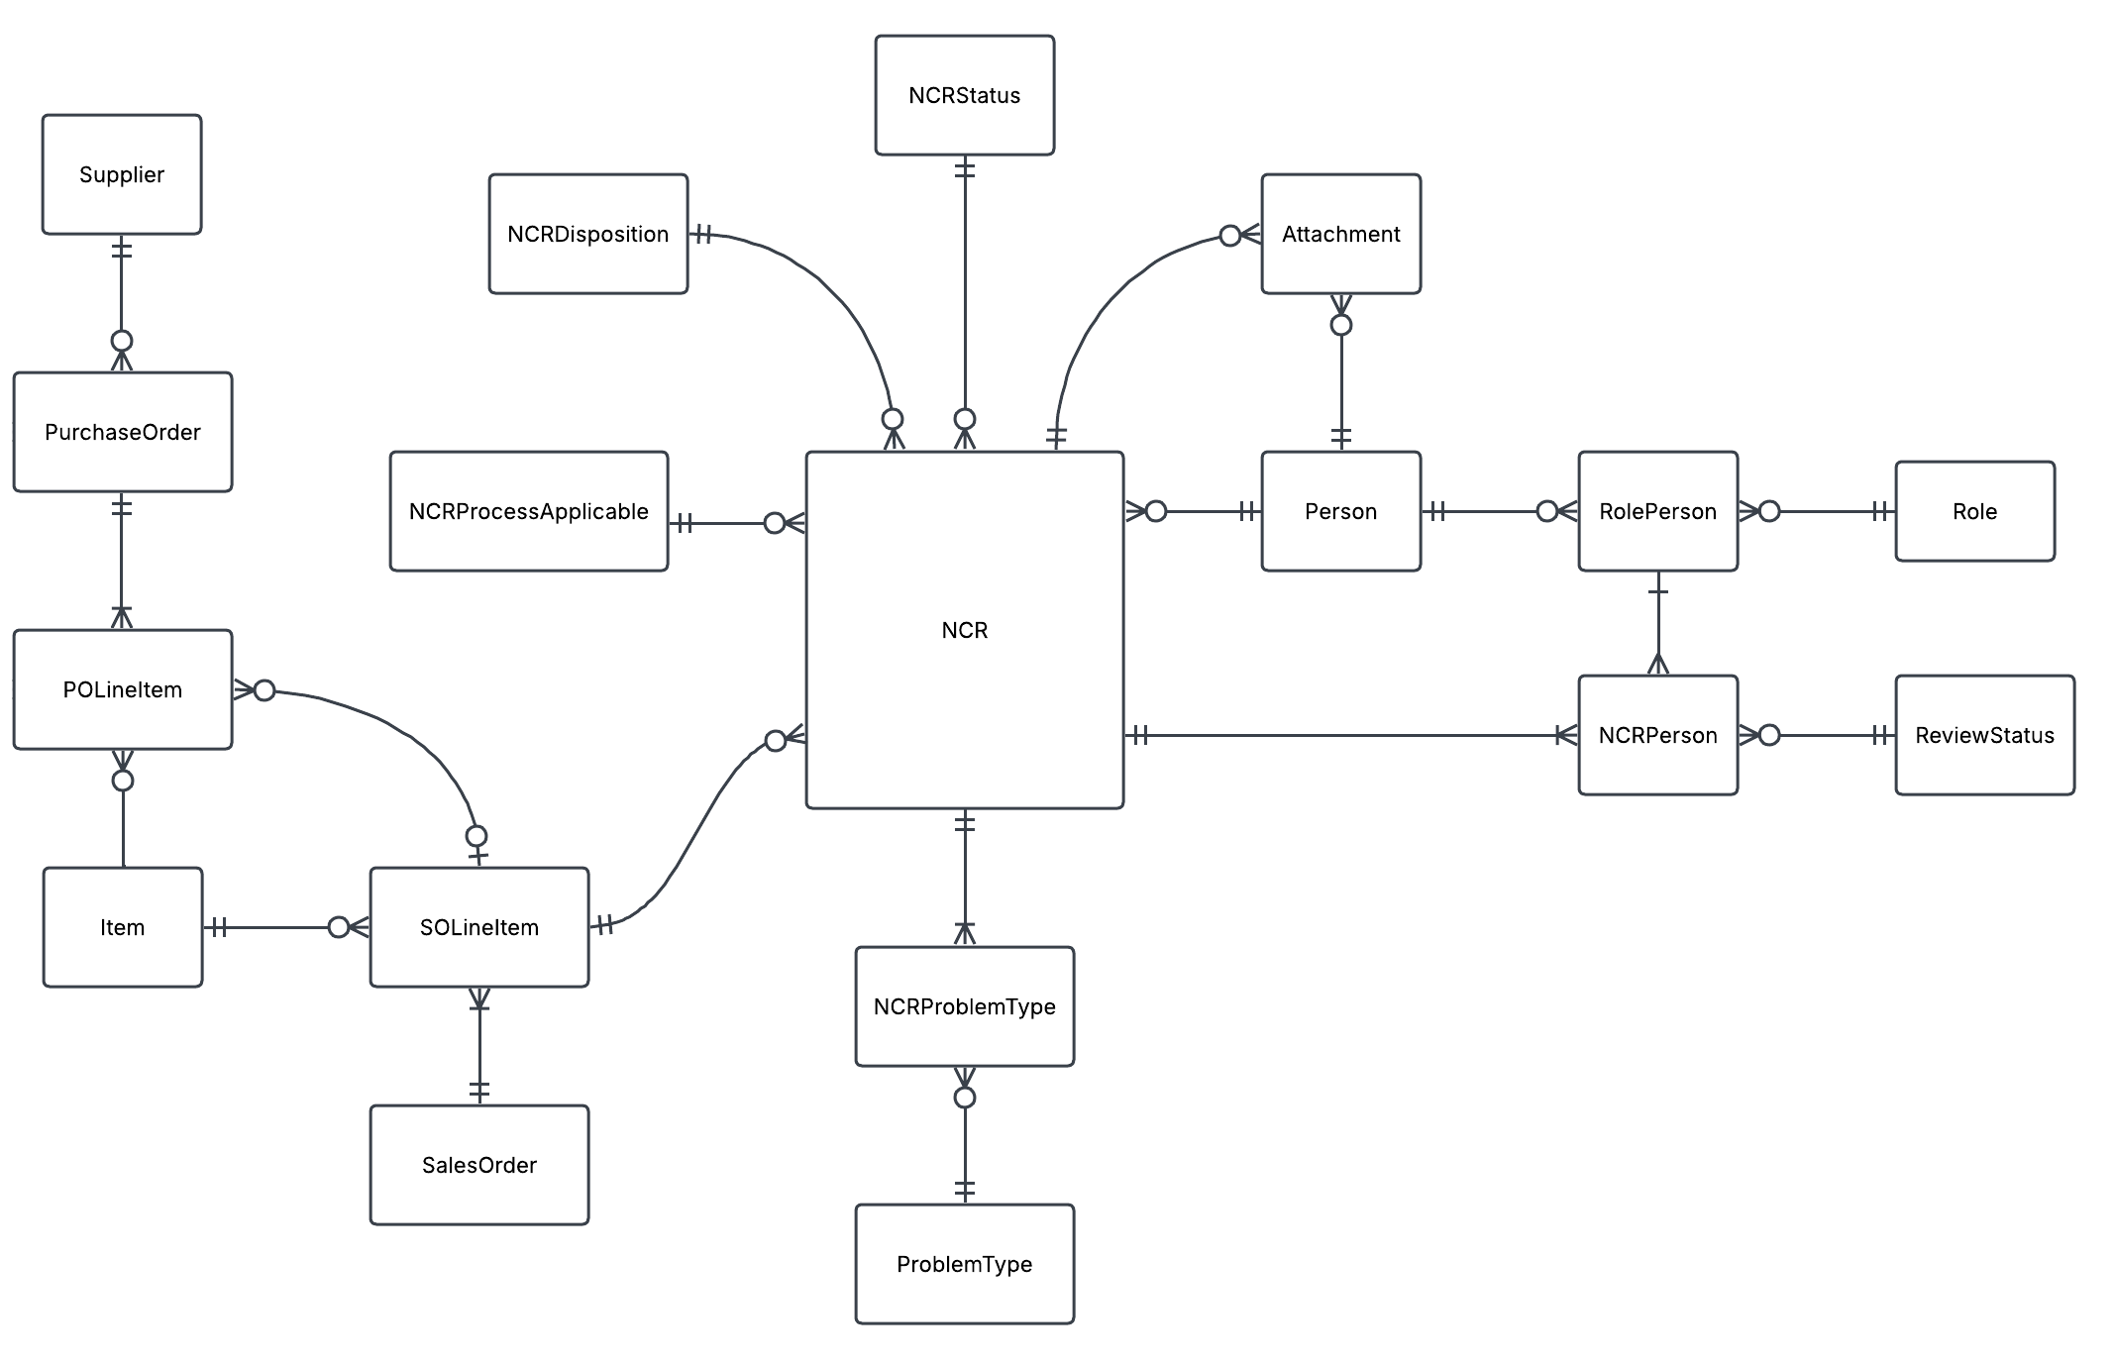
Data Model
Notes:
Jack

Slide 4
Pain Points
As a quality inspector, I want to create a new NCR but finding the next available NCR number makes it hard.
Notes:
Jake

Slide 5
Pain Points
New NCR numbers are automagically generated
Notes:
Jake

Slide 6
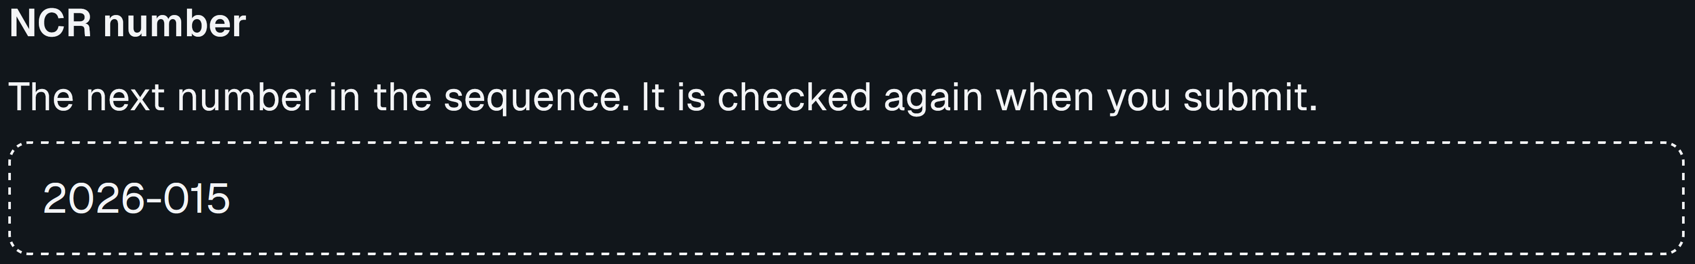
Pain Points
Notes:
Jake

Slide 7
Pain Points
As a quality inspector, I want to save a new NCR but finding the right directory on the server makes it hard.
Notes:
Edin

Slide 8
Pain Points
New NCRs are automatically saved in a central database.
Notes:
Edin

Slide 9
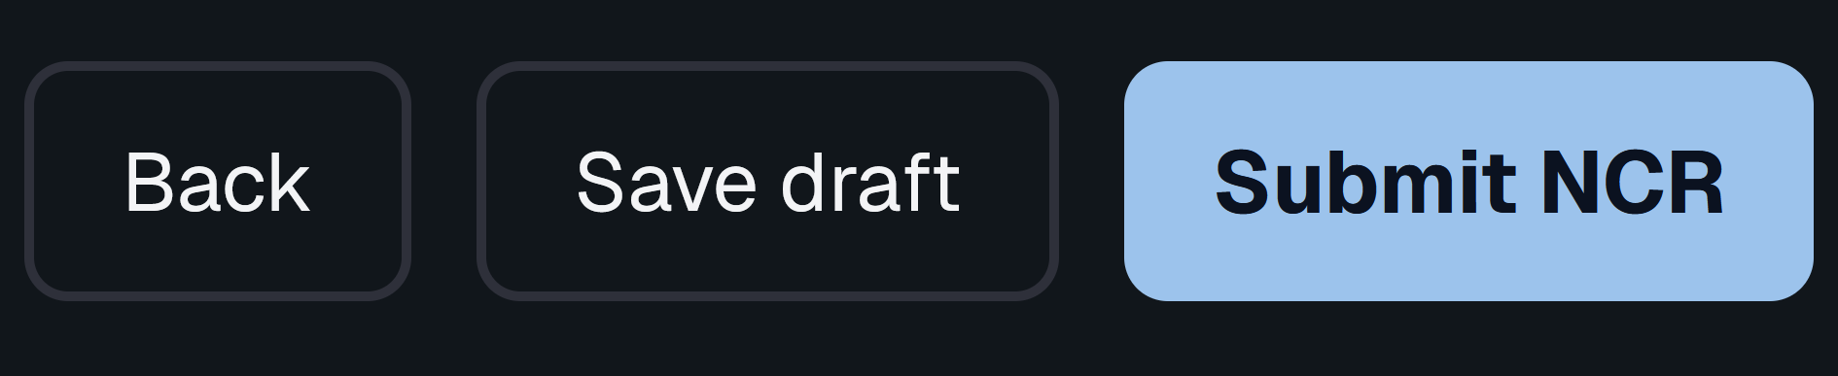
Pain Points
Notes:
Edin

Slide 10
Pain Points
As an operations manager, I want to have an NCR get completed but sending emails makes it hard.
Notes:
Kayla

Slide 11
Pain Points
Emails are sent out automatically to correct sector.
Notes:
Kayla

Slide 12
Pain Points
Notes:
Kayla

Slide 13
Q & A
Notes:
Steve

